Slide 1

Cabin Crew Manager Workshop

Slide 2
Our day….
Welcome
Ab initio - Introduction and Footprint
Break
Ab initio :
Deep dive
Special cases
Assessment Methods
YSA
Other Economy class programmes
Break
Market Stall:
Service EKcellence
On line Support
Q/A

Slide 3
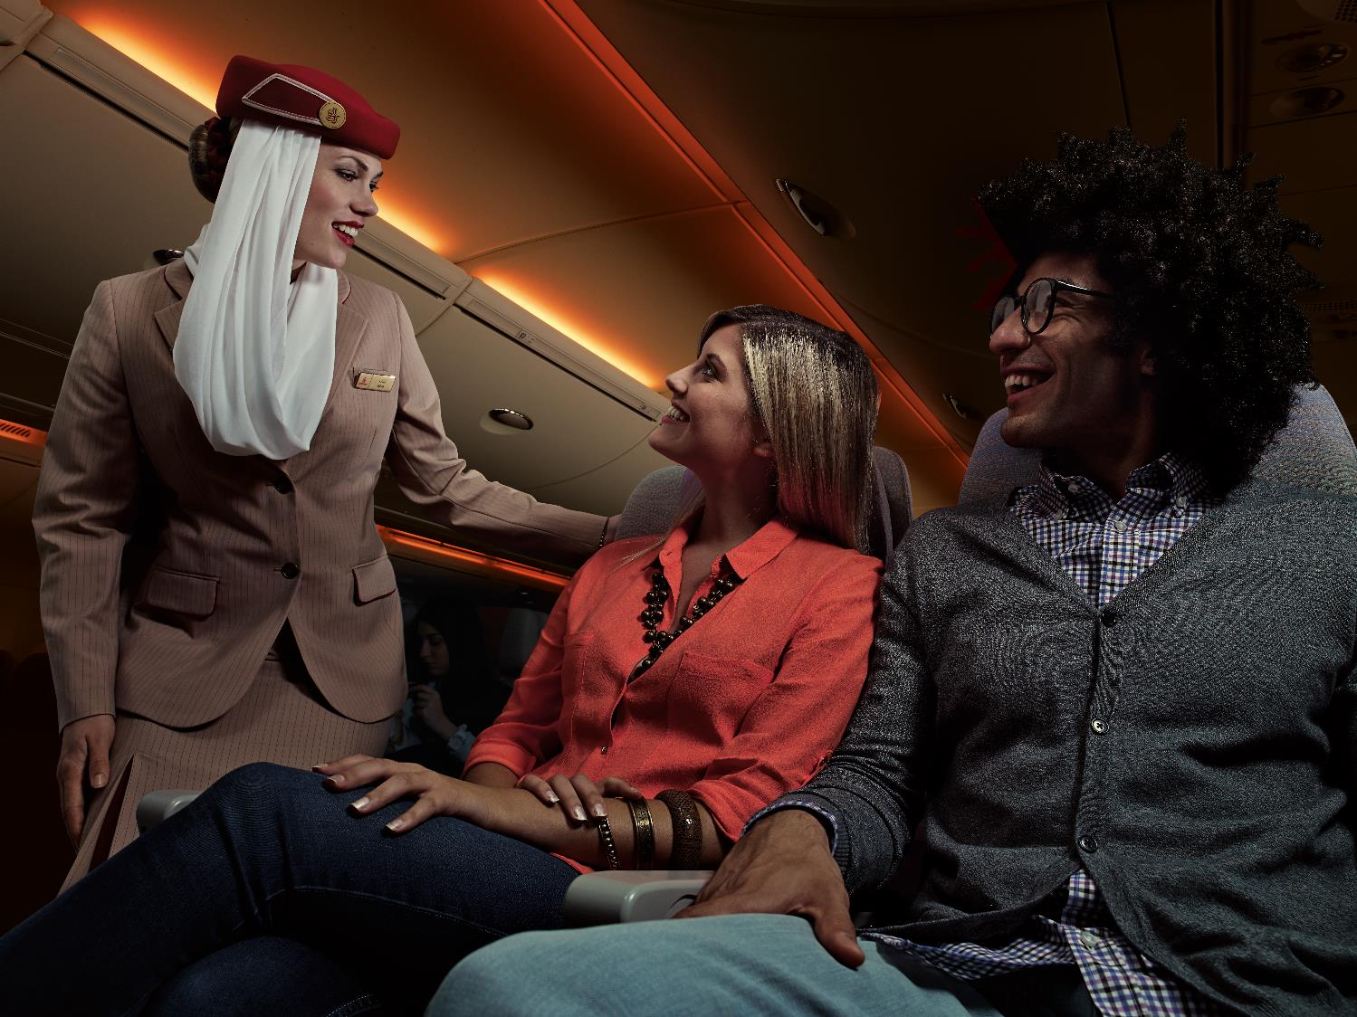
Emirates Ab initio Programme Tomorrow’s Cabin Crew

Slide 4

Tomorrow’s Cabin Crew

Slide 5
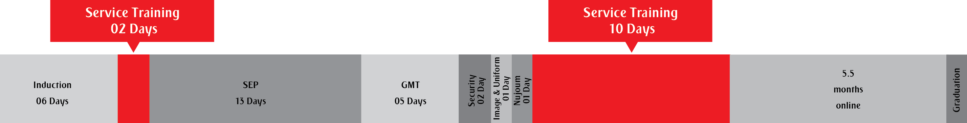
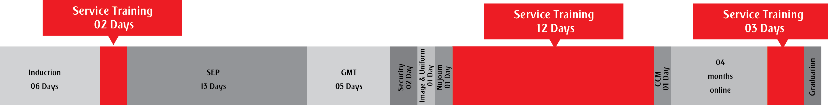
Course Duration
Previous Ab initio course duration:
New Ab initio course duration:

Slide 6
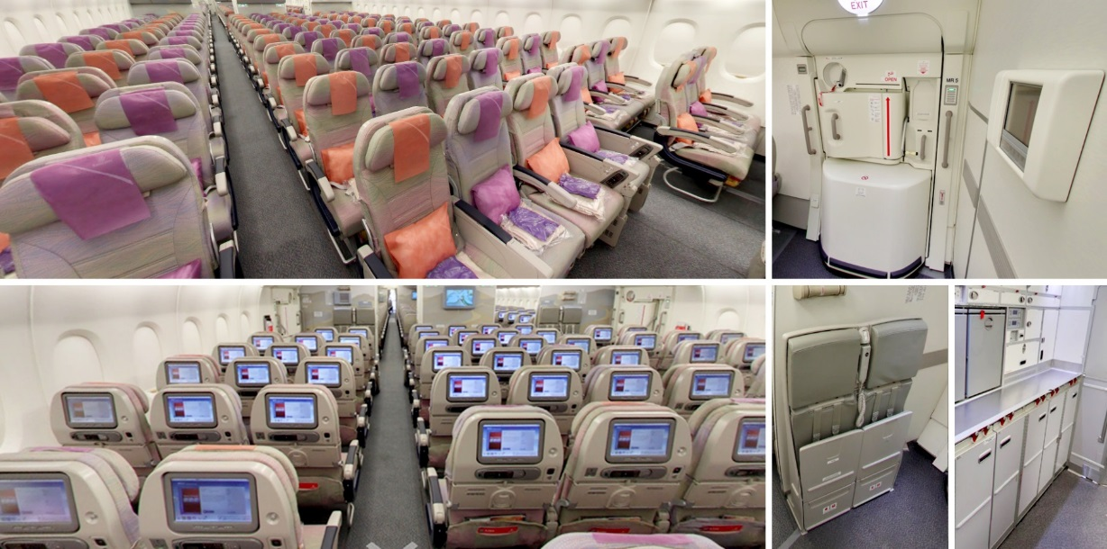
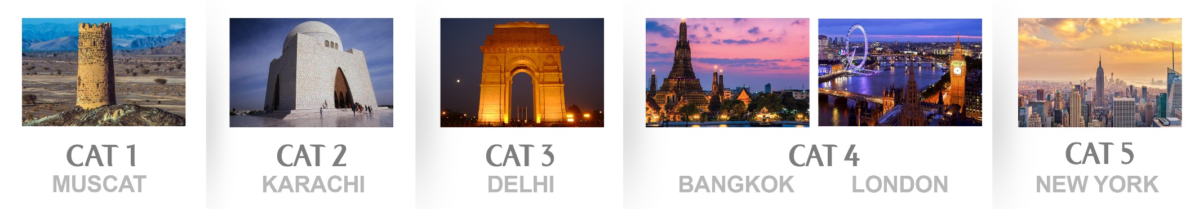
Hospitality & Customer Care Training:

Slide 7


Connecting with our people:
Increased use of multi-media to enhance learning and retain knowledge

Slide 8

Thank you

Slide 9
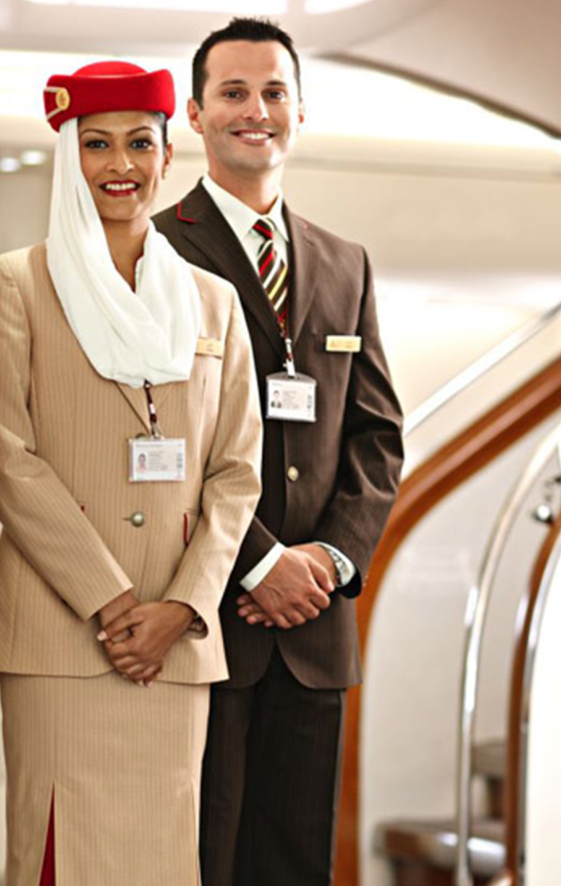
Emirates Ab initio Programme. Tomorrow’s Cabin Crew
Day 1
Day 2
Day 3
Day 4
Day 5
Day 6
Day 7
Day 8
Day 9
Day 10
Day 11
Day 12
Day 13
Day 14
© Emirates Aviation College – Cabin Crew Training

Slide 10
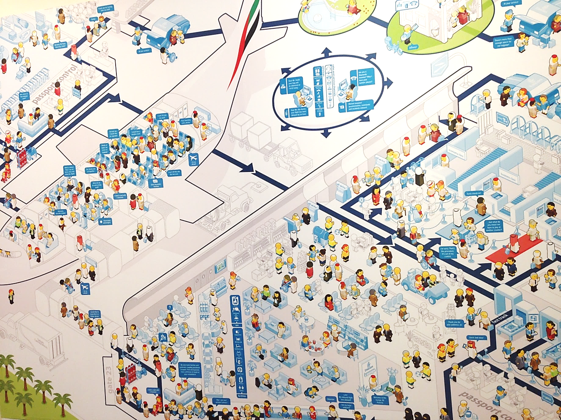
Day 1 (Induction Week)
Customer Service Day

Slide 11
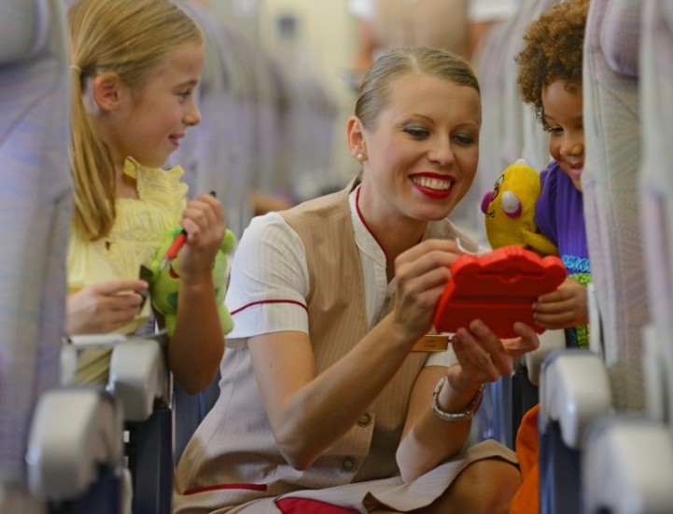
Customer Service Day
During this session the following topics will be covered:
Emirates brand values
Team building
Emotional Intelligence
Importance of cross cultural awareness
Communication/barriers to communication
Teamwork, positive attitude
Customer Journey
Customer journey touch points and values

Slide 12
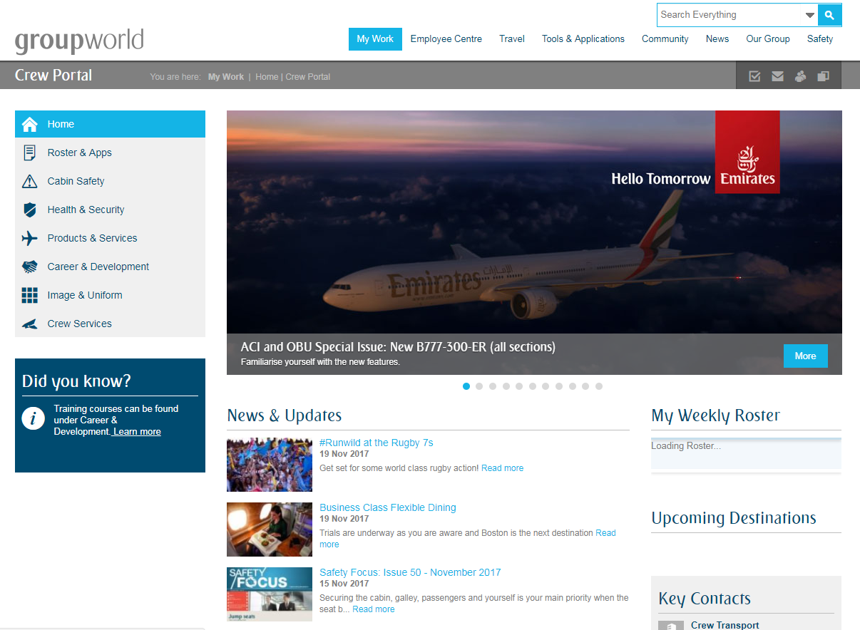
Day 2 (Induction Week)

Slide 13
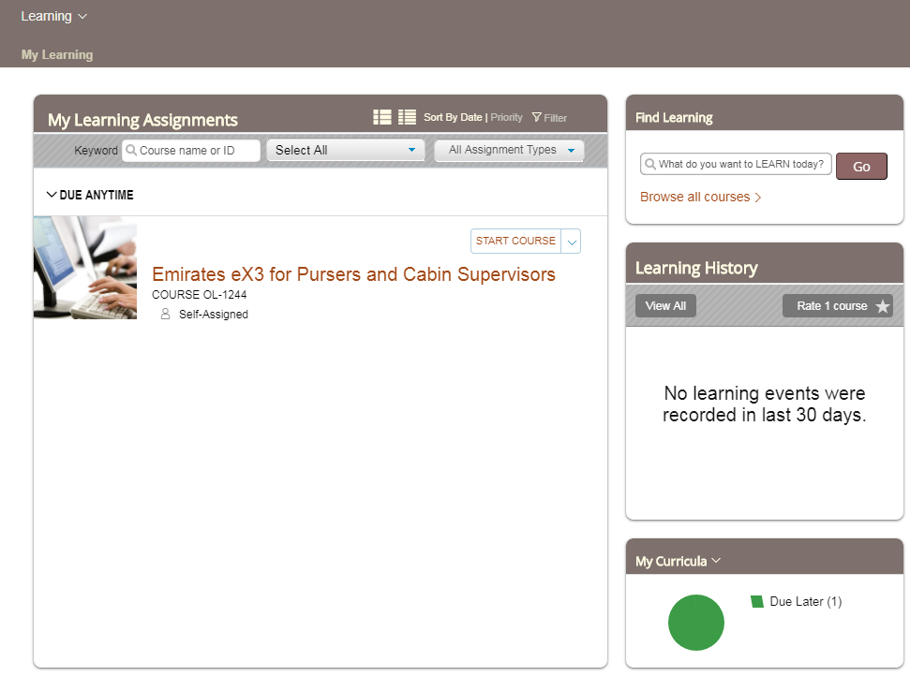
Cabin Crew Portal and IT Training
During this session the following topics will be covered:
Mobile pass - procedures and usage
Creating a password to access crew portal
Personal electronic device - system requirement for crewportal
Company email
HR Direct / Requesting Company letters
Leave Bidding
Rosters
My Learning Zone
On board Update
Trips

Slide 14
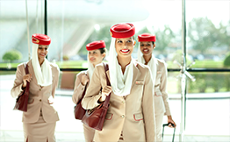
Day 3 - Thursday
Welcome and Ideal Crew
Customer Care: Customer profiles
Course Expectations
Observe Muscat Practical assessment
Image and Uniform Checks

Slide 15
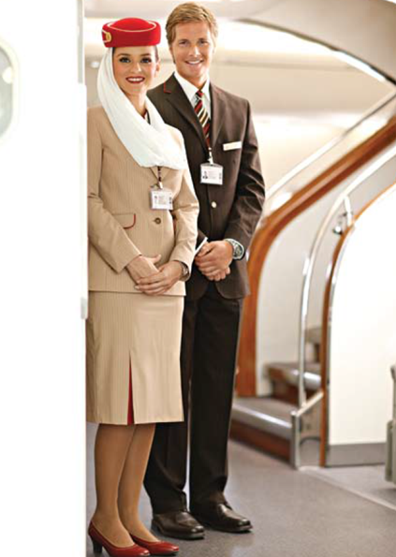
Welcome & Ideal Crew
Introduction & welcome(Cosmopolitan)
EK- a lifestyle brand
Introduction activity
Ideal crew activity
Self regulation
State is everything
Service personality
Random act of kindness

Slide 16
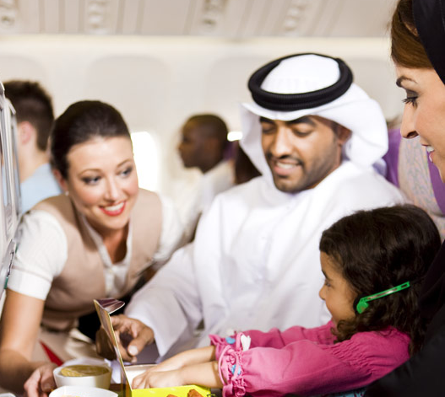
Customer Care: Customer Profiles
Linked to Customer Service Day:
Culture
Cultural Awareness activity
Arabic/Islamic Culture
Communication
Customer Journey

Slide 17
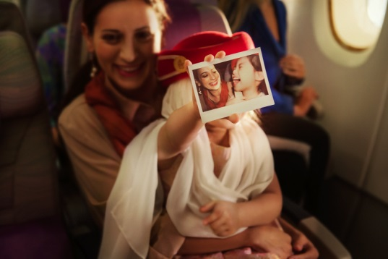
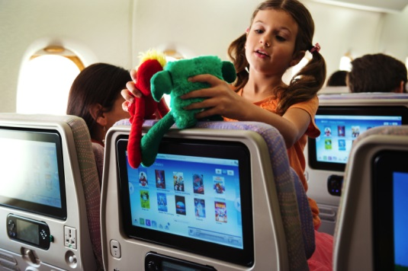
Observation-Muscat practical assessment
Learners observe their peers; the ideal crew
Simulation of flight to Muscat includes:
Special category customers
Boarding
Welcome Services
Safety Video
Securing
In-flight service
Farewell service
Disembarkation
Support of Purser and Cabin Supervisor

Slide 18
Course Expectations
Expectations
Image and Uniform
Honesty
Home-studies
Feedback
Teamwork and Courtesy
Punctuality
Environment
Hospitality & Customer Care Assessment brief
Peer : peer assessment brief
Printed Materials

Slide 19
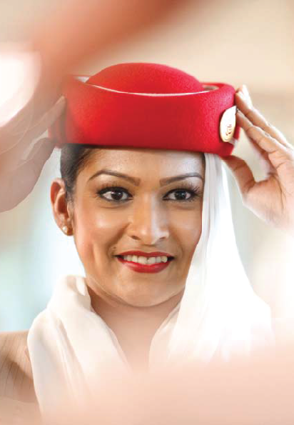
Image and Uniform Checks
Effectively provide and receive feedback regarding image and uniform standards
Trainers will highlight any development/ shortfalls and record on the Daily Continual Assessment forms

Slide 20
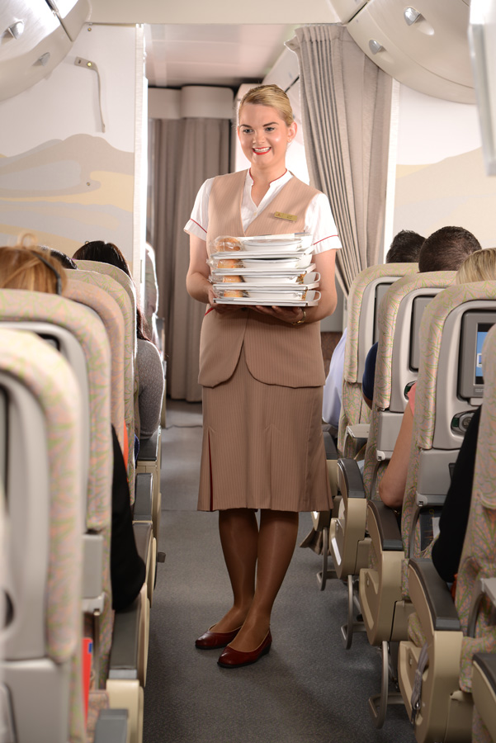
Day 4 - Sunday
Equipment Familiari-sation
Aircraft Familiari-sation
Open Book Activity
Mapping my progress 1:1
Food Session
Food Tasting

Slide 21
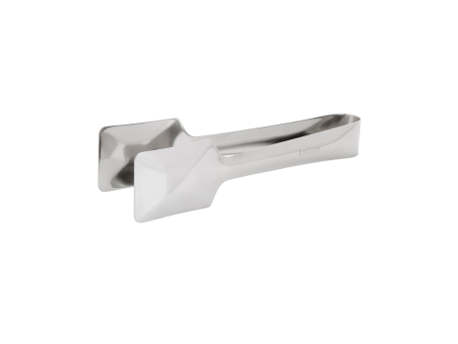
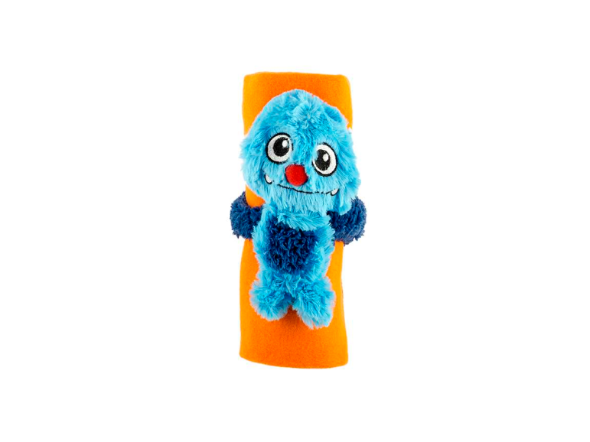
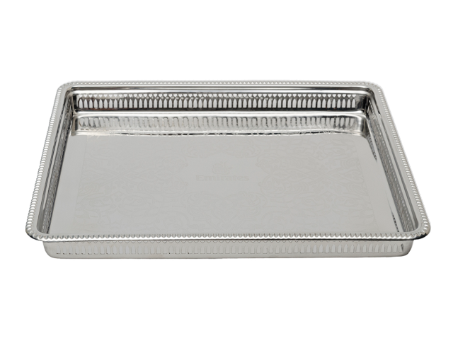

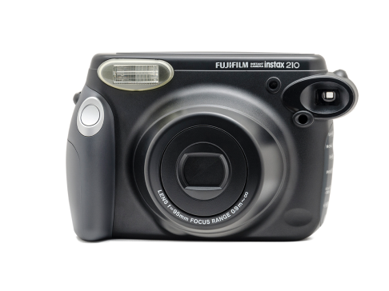
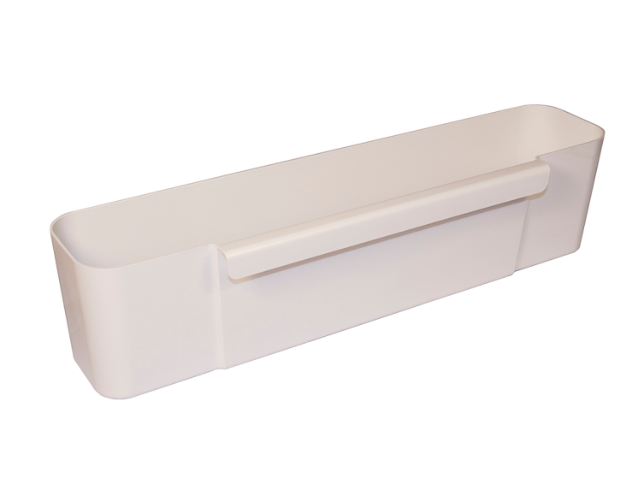
Equipment Familiarisation
Galley Activity
Container exploration
Group discussion and clarification
Equipment Demonstration Room
Explore the amenities and service equipment available in all cabins

Slide 22
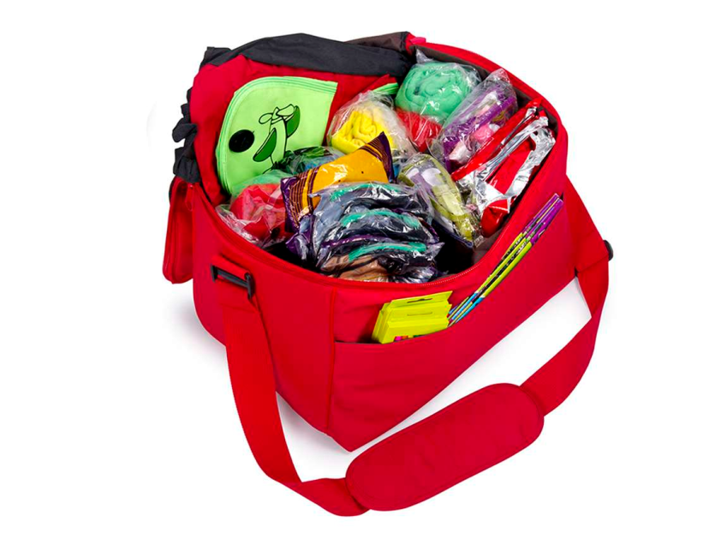
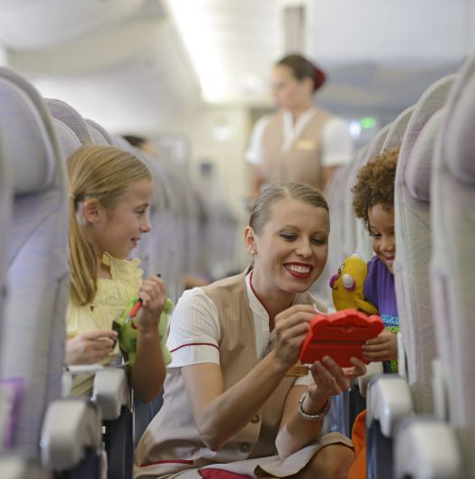
Aircraft Familiarisation
Cabin Familiarisation B777/A380
Ships Paper Bag
Ships Library
Folding trolley
Menu bags
Cabin Dress materials
Headsets Bags
Toy Bags
Bassinets
Blankets
Emirates Holiday Brochure
Seat Pocket Contents
Dust Pan & Brush

Slide 23

Open Book Assessment activity
Answer questions and explore seat pocket contents printed materials and manual

Slide 24
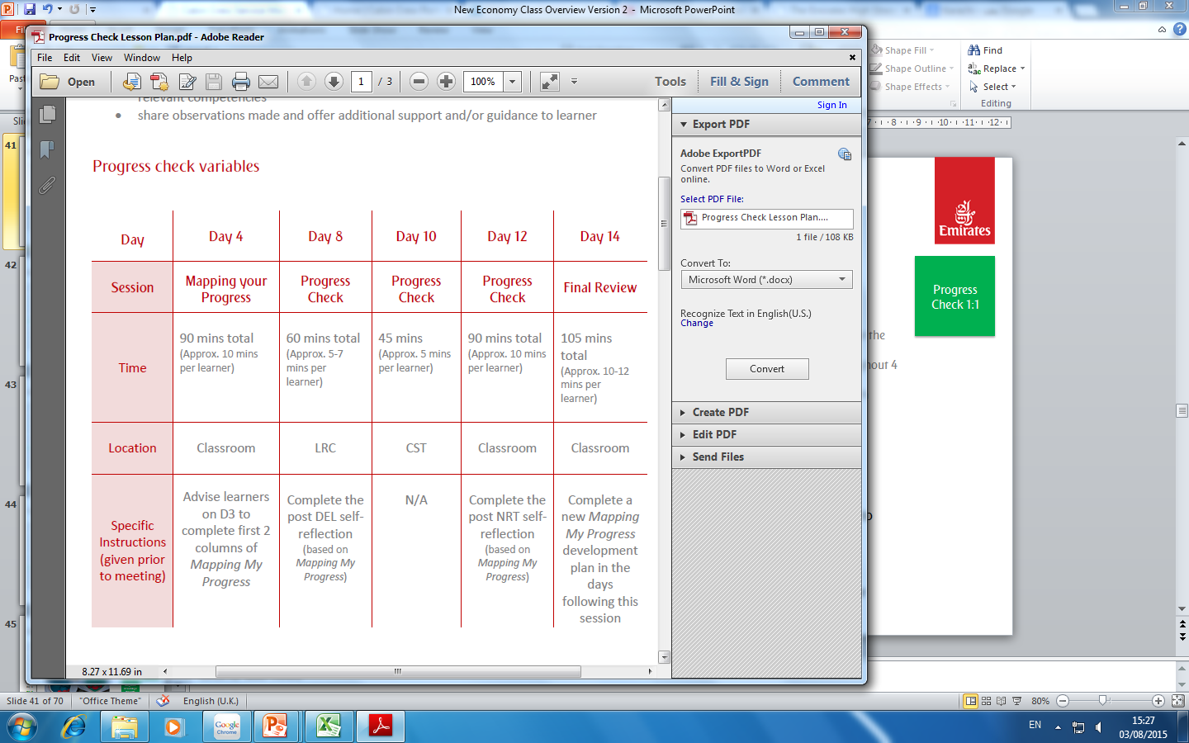
Mapping my progress 1:1
Through this learners will:
Differentiate between the 4 competencies and key behaviour indicators
Complete a personalised development plan to evaluate progress throughout the 14 day course
The following will be maintained by trainer for each progress check:
1:1 time for learners to share their self-reflection in relation to “mapping your progress” and discuss their progress

Slide 25
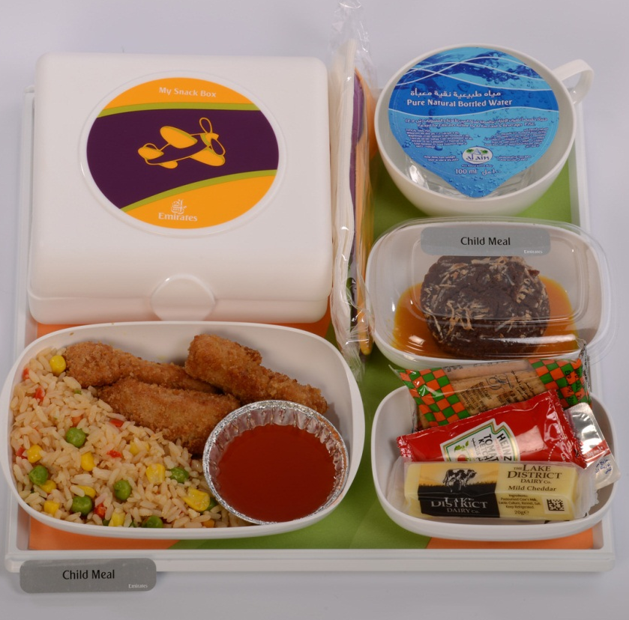
Food Session
Special Meals
Menu Cycles
Reasons customers order special meals
Special meal codes
Nut Free meals
Special meal loading and stickers
Special meal delivery
Customer interaction
SPML delivery 3 steps
SPML not available - problem solving
Iftar boxes
Food Tasting Activity
Learners taste a variety of food from the Emirates catering cuisine
Add your dish to the mix

Slide 26
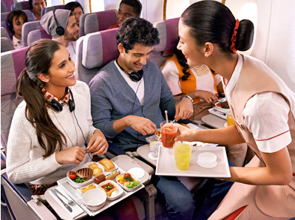
Day 5 - Monday
Welcome Services / Farewell Services
Welcome Services Peer play Activity
Aircraft Documentation
Bar session
Bar Service Peer Play Activity

Slide 27
Welcome Services
The following topics will be covered:
Pre-boarding duties
Ready to board concept / Galley Preparation
Boarding
Pro-active boarding
Special category customers discussed in detail
Welcome Services Demonstration
Public Announcements (PA)
Farewell Services
Welcome Services practice: Peer : Peer Activity

Slide 28
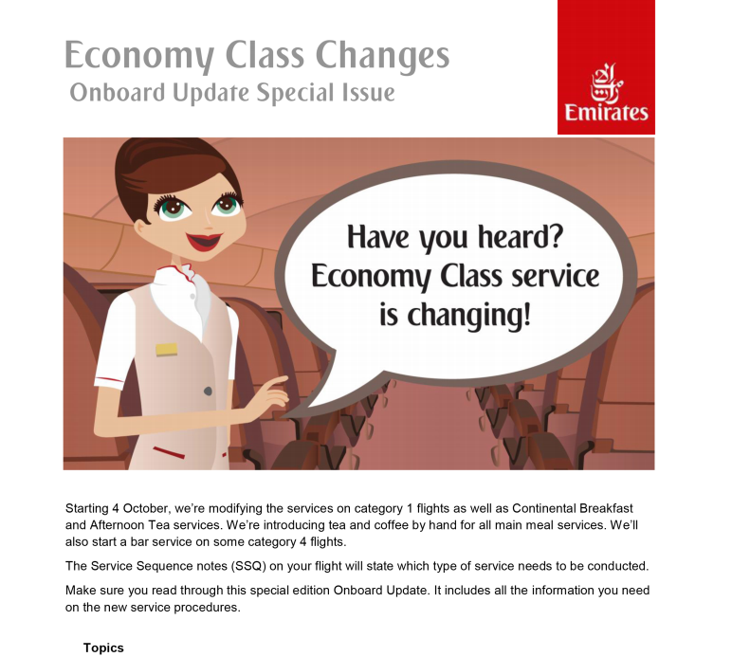
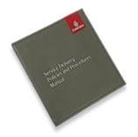
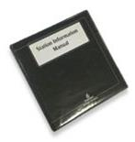
Aircraft Documentation
Discovery of the cabin crew service manual
Group activity to locate the information about:
Flight categories
Meal Service details
G2 General Duties
Crew portal identifying the locations and importance of:
Flight instructions
On Board Updates

Slide 29
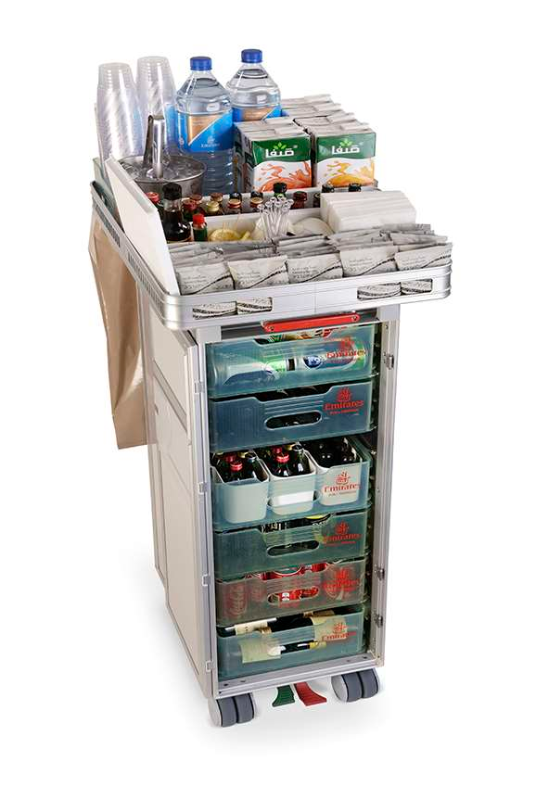

Bar Session
Bar Cart Description
Inside and outside
Exploration activity of bar cart contents
Liqueurs discussion
Wine discussion and demonstration
Demonstration of drinks delivery by trainer
Route specific information
Discussion of non-alcoholic bar carts
Handling an Intoxicated Customer
Recap on 4 D’s
Bar Service Peer : Peer Activity

Slide 30
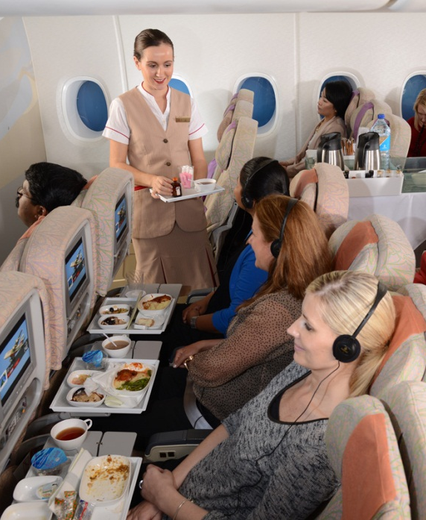
Day 6 - Tuesday
Cart Set Up
On-board Services LU/DN/HB
Demonstration and Practice
Customer Care: Customer Service
Knowledge Assessment
1
Hospitality: Galley Management
Corporate Knowledge Progress Check

Slide 31
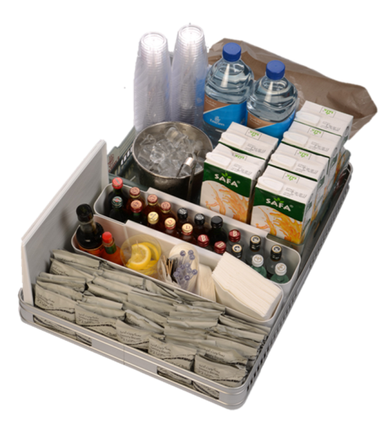
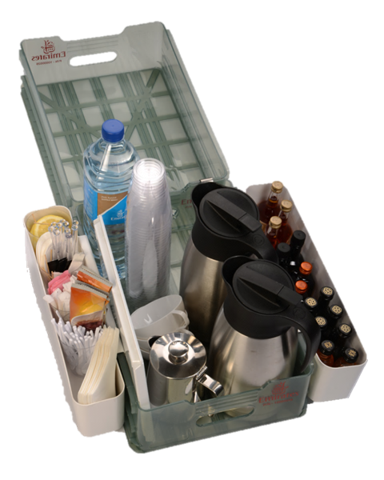
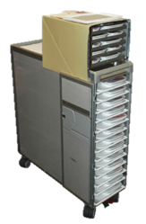
Cart Setup for LU/DN demonstration
Learners set up the carts using the modules book:
Bar cart
Meal distribution cart – category 4 & 5
Clearance cart with water

Slide 32
Lunch / Dinner / Hot Breakfast Demo (Cat 3/4/5)
Discussion and Demonstration of the Service Steps
Emphasis on importance of rolling service
Discussion of differences with Hot Breakfast service
Discussion of differences for LU/DN cat 1 and 2

Slide 33
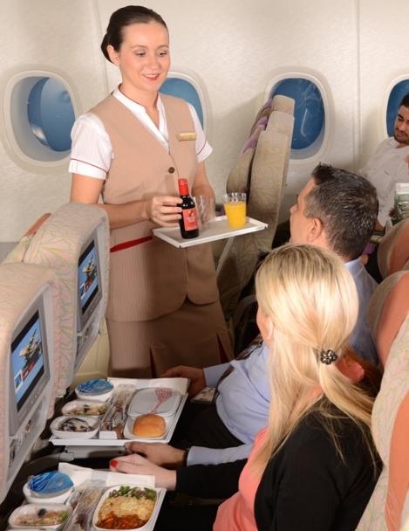
Lunch / Dinner Practice
Learners practice serving meals and drinks
Peer : peer observations:
Learner 1: crew member – serves the meal/ drink
Learner 2: the customer
Learner 3: another customer
Learner 4: the observer – has the checklist
Learners practice the following:
Serving one alcoholic drink from the bar cart
Serving two meal trays
Serving one alcoholic drink from the drinks drawer
Focus area of customer interaction:
Personal demeanour i.e. approachable, polite and friendly
Body Language i.e. smile appropriately, appropriate eye contact and maintained appropriate posture
Polite and appropriate service phrases
Menu terminology when offering customer meals and drinks

Slide 34
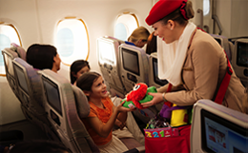
Customer Care: Customer Service
Linked to Customer Service Day
Basics of exceptional customer care
Apply customer service skills in order to create a wow of hospitality and customer care experience
Customer Expectations
Active listening
Language Barriers
Emotional Intelligence
Ownership and Responsibility
Positive acknowledgement
Acknowledgement Activity - Learners practice to answer customer scenarios
Customer wants to visit flight deck
Customer requests to pray in the middle of service
Customer requests a beverage during boarding
Customer requests bassinet on ground
Customer requests for a free upgrade
During boarding customer wants to offload himself

Slide 35
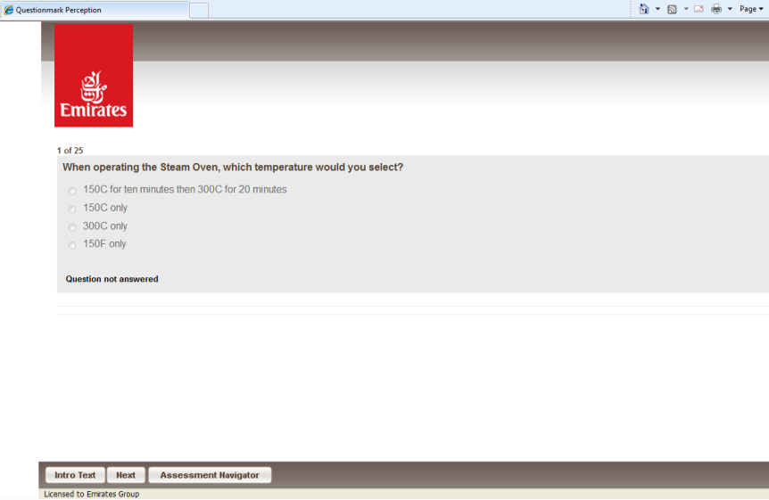
Knowledge Assessments x 3 ( days 6, 8, 10 and 13)
Computer based assessment
Pass mark: 80%
Knowledge Assessment
1

Slide 36
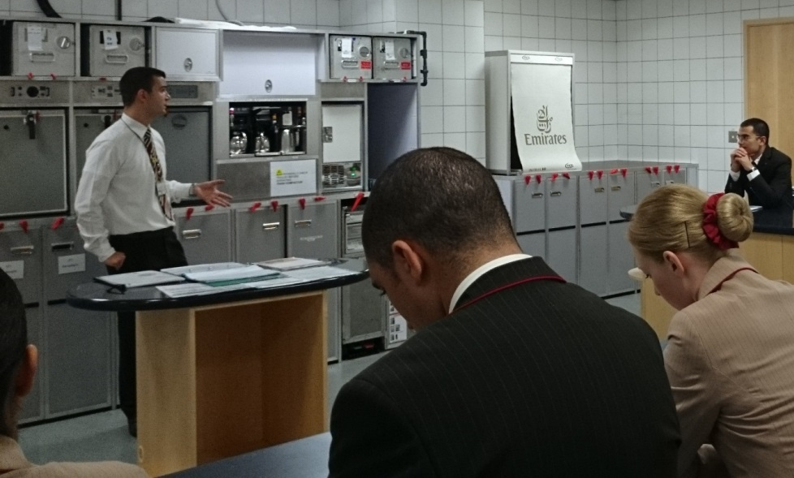
Galley Management
Hospitality: Galley Management
Discussion of the following:
Galley Positions
Activity 1: Learners in 3 groups design a presentation on the following
3 topics and must include duties and responsibilities of the galley operator:
Pre Departure duties
After take off and cruise duties
Pre and post landing duties
Discussion of various forms
Activity 2: Equipment exploration

Slide 37
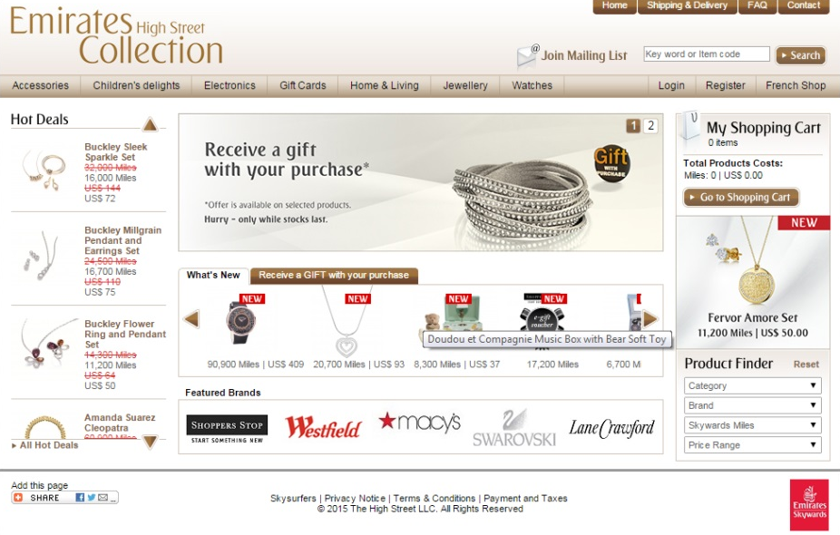
Corporate Knowledge Presentation Brief
Corporate Knowledge Progress Check
Corporate Knowledge Presentations Brief:
Learners are divided into groups of 3
Each group will be given 1 topic to research
Each group will have a maximum of 8 minutes to present their topic on Day 11 of the course
Groups may present each topic in any way, but must not exceed 5 minutes
Each group must answer the corporate knowledge questions relevant to their topic available in their module book
Topics:
Emirates Skywards programme
Emirates airline foundation
The Emirates Group
Emirates.com
Emirates High Street
History of Emirates Group

Slide 38
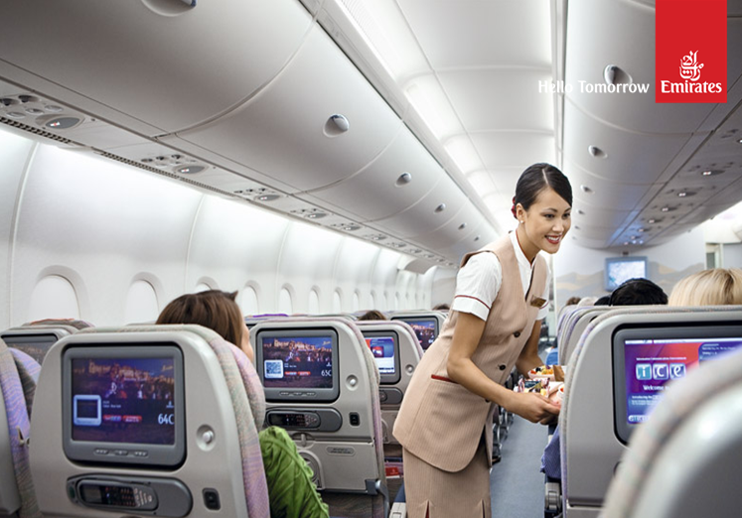
Day 7 - Wednesday
Customer Care: Winning Customer Loyalty
Customer Care:
We Care
Hospitality & Customer Care Assessment: DEL
Delhi Debrief

Slide 39

Customer Care: Winning Customer Loyalty
The importance of understanding the impact that our words have on our customers and on each other
Rice Experiment video
Positive words vs. negative words
Managing Situations Framework:
Positively acknowledge: Apologise-Emphasise / Give assurance
Action Taken
Discuss options / Give the news
Follow up
Learners practice how to positively acknowledge customer requests
Customer Scenarios Activity
Customer wants to visit First Class
Customer insists on a free upgrade
Customer wants crew’s personal number
Customer wants a low calorie meal
Customer wants to sleep in business class
Parent with infant insist on bassinet
Colleague as a customer request items from business class
Customer offers you a tip for the excellent service offered
Customer Care: Winning Customer Loyalty

Slide 40
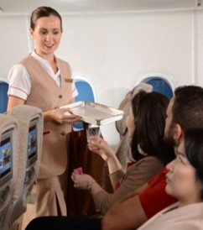
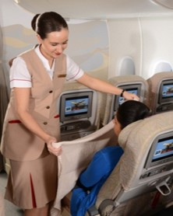
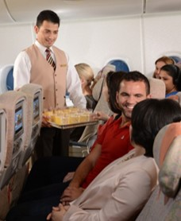
Customer Care: We Care
Recap from Home studies / We Care video
All 3 cycles discussed and practiced in the CST using appropriate service phrases and promoting Emirates products

Slide 41
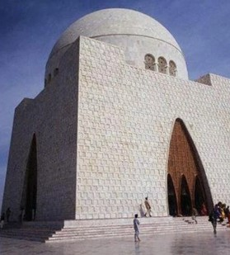
Hospitality & Customer Care Assessment: Karachi
Simulation of flight to Karachi includes:
Team talk with Cabin Supervisor
Pre-flight Security Search
Boarding
Welcome Services
Securing and passing checks
In-flight service (Hot Breakfast Cat 2)
Customer interaction/care
Farewell service
Disembarkation
Assessment Details:
Assessment is assessed by trainers and recorded in continual assessment form
Half of the learners act as cabin crew, the other half as customers including a range of special category customers: HVC, Deportee, UM, Visually impaired, Honeymooners, WCHR and Qantas HVC
Trainers act as customers and support learners as Captain, Purser, CSV, and trainer
Trainers observe overall achievement in the 4 competencies: Customer Service Orientation, Professionalism, Teamwork and Organizing for Results

Slide 42

Day 8 - Thursday
Hospitality & Customer Care Assessment: KHI
Cart
Set up
On-board Services LB/AT/CB
Demonstration and Practice
Knowledge Assessment
2
Progress Check 1:1
KHI
Debrief
1:1

Slide 43
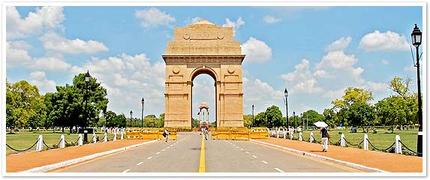
Hospitality & Customer Care Assessment: Delhi
Simulation of flight to Delhi includes:
Team talk with Cabin Supervisor
Pre-flight Security Search
Boarding
Welcome Services
Manual Safety Demonstration
Securing and passing checks
In-flight service (Lunch Cat 3)
Customer interaction/care
We Care
Farewell service
Disembarkation
Assessment Details:
Trainer acts as CSV in the galley, leading by example and supporting learners
Assessment is peer assessed
Half of the learners act as cabin crew, the other half as customers including a variety of special category customers: HVC, Deportee, UM, Visually impaired, Honeymooners, WCHR and QF HVC
Integrated scenarios: Oven Smoke, Hatrack space, Turbulence, Intoxicated customer
Other trainer acts as customer and supports learners as Purser, Captain and trainer

Slide 44
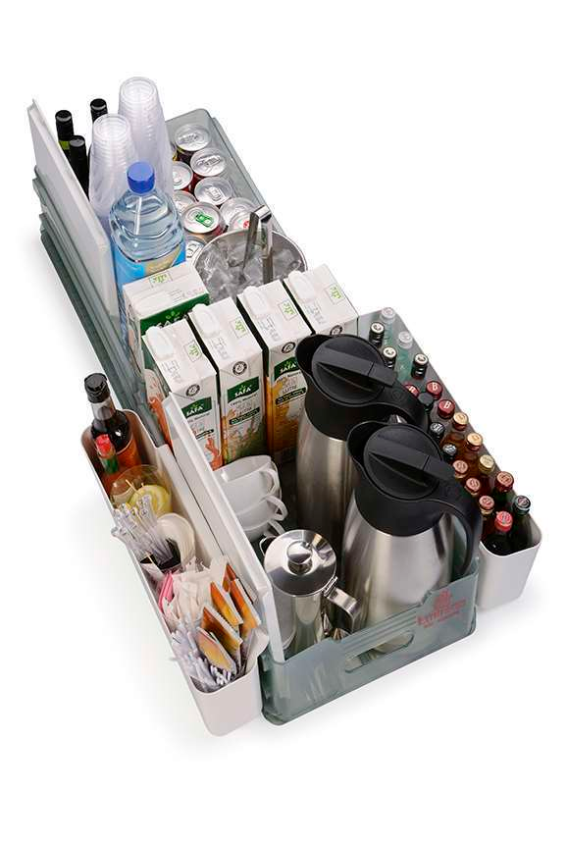
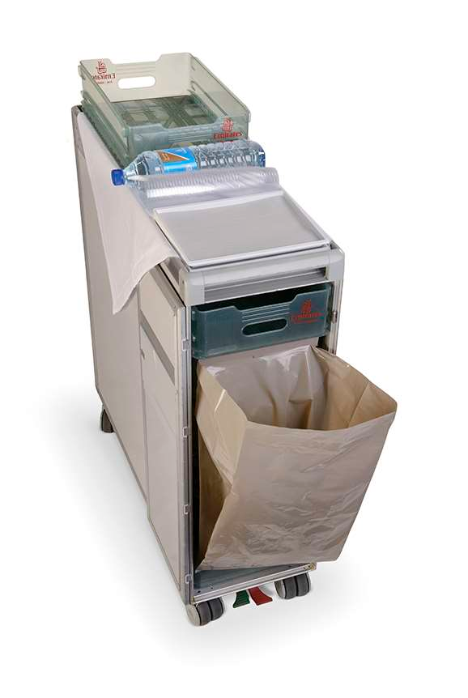
Cart Setup for LB/AT/CB/EB demo
Learners set up the carts using the modules book:
1 Light bites bar beverage meal carts
1 AT cart & LB clearance carts
1 Bar beverage cart

Slide 45
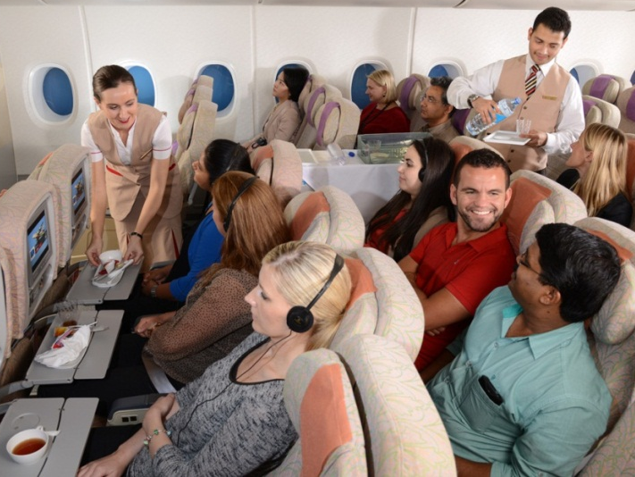
LB/AT/CB Demo
Discussion and Demonstration of the Service Steps:
Special meals
Light Bites delivery with drinks (Bar beverage meal cart)
4 corner style service
Highlighting the ‘Golden Rule’
Discussing the buddy system
Light Bites clearance
Final cabin clearance
Discussion of the following:
Pizza preparation
Snack basket/box in Economy class
LB/ AT/CB/EB Practice – Peer: peer assessed

Slide 46
Progress Check 1:1 / DEL Debrief
Through this learners will:
Complete a 2nd personalised development plan to evaluate progress throughout 4 months of flying
Reflect and discuss personal performance through 1:1 meeting with trainers
Discussion of performance with regards to DEL practical
The following will be maintained by trainer for each progress check:
Discussion is noted on continual assessment form under professionalism and any other relevant competencies
Learners share observations made and offer additional support and/or guidance to learner

Slide 47
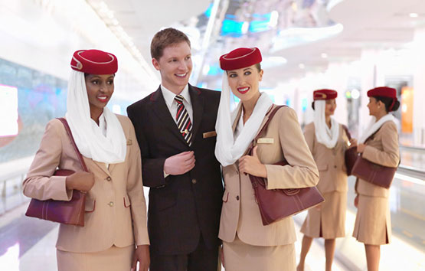
Day 9 - Sunday
Hospitality:
Bar Paperwork
Customer Care: Anticipate & Manage
Hospitality & Customer Care Assessment: JFK
JFK Group Debrief
Corporate Knowledge Progress Check

Slide 48

ABC Bar Paperwork
Learners complete 2 ABC Bar Paperwork exercises for home studies
Compare home studies to PTT slide examples:
DXB - SIN
SIN – MEL
In class, learners complete another set:
DXB – LHR
C209 discussion
Paperwork requirement for UK destination
How to fill it in
Distribution procedure
Learners complete 1 example of C209

Slide 49

Customer Care: Anticipate & Manage
Customer Feedback Topics:
Crew behaviour
Products & Services
Aircraft interiors
Anticipating and managing our special category customer’s needs
Trainers role play a service recovery scenario following the managing situations framework
Customer Service Activity
Learners role play the following scenarios;
Excess baggage
Accidental Spillage of Red Wine
Reclined seat during meal service

Slide 50

Day 10 - Monday
Selling Techniques
Knowledge Assessment
3
Bar Assessment
1
Hospitality & Customer Care Assessment: LHR
Progress Check 1:1
KHI
Debrief
1:1

Slide 51


Selling Techniques
During the sessions, learners will
Describe the Emirates products
Develop a winning mind set
Apply selling techniques in order to increase sales
Selling Techniques:
Know it
Believe it
Sell it:

Slide 52

Bar Assessment 1 and 2
Learners complete one set of ABC Bar paperwork and C209 forms

Slide 53

Hospitality & Customer Care Assessment: London Heathrow
Simulation of flight to London Heathrow includes:
Teamtalk with CSV
Pre-flight Security Search
Boarding
Welcome Services
Securing and passing checks
In-flight services:
Lunch & Afternoon Tea Cat 4
Customer interaction/care
We Care
Farewell service
Disembarkation
Assessment Details:
Assessment is assessed by trainers and recorded in continual assessment form
Half of the learners act as cabin crew, the other half as customers including a range of special category customers
Trainers act as customers and support learners as Captain, Purser, CSV and trainer
Trainers observe overall achievement in the 4 competencies: Customer Service Orientation, Professionalism, Teamwork and Organizing for Results
Group feedback regarding their performance in the practical assessment

Slide 54
Progress Check 1:1
Through this learners will:
Reflect and discuss personal performance through 1:1 meeting with trainers
Discussion is noted on continual assessment form under professionalism and any other relevant competencies
Learners share observations made and offer additional support and/or guidance to learner
Progress Check 1:1

Slide 55

Day 11 - Tuesday
Corporate Knowledge Presentations
NRT
Briefing Safetalk
& Purser Folder
Hospitality & Customer Care Assessment: NRT
NRT
Group Debrief
Customer Care: Emirates Skywards

Slide 56

Hospitality & Customer Care Assessment: New York
Simulation of flight to New York includes:
Teamtalk with CSV
Pre-flight Security Search
Boarding
Welcome Services
Securing and passing checks
Hot Breakfast, Light Bites, Dinner Cat 5
Customer interaction/care
We Care
Farewell service
Disembarkation
Assessment Details:
Assessment is assessed by trainers and recorded in continual assessment form
Half of the learners act as cabin crew, the other half as customers including a range of special category customers
Integrated scenarios: Customer Smoking, Asthma, Non-compliance and Burn
Trainers act as customers and support learners as Captain, Purser, CSV and trainer
Trainers observe overall achievement in the 4 competencies: Customer Service Orientation, Professionalism, Teamwork and Organizing for Results
Group feedback regarding their performance in the practical assessment

Slide 57
Customer Care: Emirates Skywards
Introduction
Methods of enrolment
Navigate Emirates.com / Emirates Skywards to show the following:
Membership tiers and benefits
Earning and Spending Miles
Emirates Skywards partners
The Emirates High street
Emirates Sky surfers
Qantas and Emirates Partnership
iO’s
Activity
Discuss ways to assist high value customers during their journey: before take-off, during cruise, pre and post landing.
Trainers role play additional points i.e. introduce self,
Preferred drink, using name and welcome back

Slide 58



JFK Briefing / Safetalk and Purser Folder
Briefing Discussion:
3 stations: Documents, Image and Uniform and Safetalk
Basic Briefing outline:
Introductions
Mandatory documents check
Flight details
Safe Talk – each learner answers a question
Work Positions
Purser closing brief
CSV brief
Crew Ops / Purser Folder Discussion
General Declaration
Price list for upgrades
PA’s – English and Arabic
Voyage Report 1 (VR1)
Service Sequence (SSQ)
We care Schedule form
Customer cards
Crew rest strategy form
Request for Medical Assistance

Slide 59

Hospitality & Customer Care Assessment: Bangkok
Simulation of flight to BKK includes:
Teamtalk with CSV
Pre-flight Security Search
Boarding
Welcome Services
Securing and passing checks
In-flight services:
Bar Service/Lunch
Customer interaction/care
We Care
Farewell service
Disembarkation
Assessment Details:
Assessed by trainers and recorded in continual assessment form
Integrated scenarios: Fainting, Abnormal smell, Angina, sleeping on the floor
Trainers act as customers and support learners as Captain, Purser, CSV and trainer
Trainers observe overall achievement in the 4 competencies: Customer Service Orientation, Professionalism, Teamwork and Organizing for Results
Group feedback regarding their performance in the practical assessment

Slide 60

Day 12 - Wednesday
Flight Review
Hospitality & Customer Care: Cabin Systems
Mapping my progress 1:1
Customer Care:
What our Customers are saying
Skytrax & CASA
Deep Dive
Aircraft Documentation:
Aircraft Manuals
Our Stakeholders

Slide 61

Cabin Systems
During the session learners:
Identify the different Cabin Systems
Familiarize with the operation of IFE systems
Efficiently handle troubleshooting
Topics covered:
ice On Demand & Entertainment
ice
ice Digital Widescreen
ice Digital Widescreen New Look & Feel
Information:
Airshow / News and Sports Headlines / Cameras
Communication
In-Seat Phone /SMS and Email / Emtel
Wi-Fi and Mobile communication
IFE Troubleshooting Options
Economy Class Seat functions

Slide 62

Customer Care: What our customers are saying Skytrax & CASA / Deep dive
C.A.S.A. and Market Research
Impact of social media on the Emirates brand
Apply customer service skills to solve customer scenarios
Skytrax / Airs@t
Deep Dive Activity:
Learners discuss a variety of customer
scenarios and discuss how to resolve them in their groups.

Slide 63
Progress Check 1:1
Through this learners will:
Reflect and discuss personal performance through 1:1 meeting with trainers
Discussion is noted on continual assessment form under professionalism and any other relevant competencies
Discussion of performance with regards to JFK practical
Learners share observations made and offer additional support and/or guidance to learner

Slide 64
Aircraft Documentation
Locate information from all Manuals
Various items in the Documents Folder
Recap documents covered in other disciplines:
Fatigue form
Hazard Label Description Card
Witness Statement
Medical Incident Report Form
Crew Accident Report Form
Communicable disease Form
Aircraft Documentation:
Aircraft Manuals

Slide 65


Our Stakeholders
Gain awareness of key Emirates internal & external stakeholder groups
Identify how support can be offered to these stakeholders
Our Stakeholders:
Product Development
EKFC (Emirates Flight Catering)
Ground staff
Engineering
Dispatchers
Airport and Airport Lounges
CASA
Cabin Crew Management
Retail Services
Catering
Cabin Crew Training
Our Stakeholders

Slide 66

Day 13 – Thursday
Bar Assessment
2
Knowledge Assessment 4
Seat Operation
Mapping my progress 1:1
Hospitality & Customer Care Assessment: DOH
DOH Group Debrief

Slide 67

Bar Assessment 2
Learners complete one set of ABC Bar paperwork and C209 forms

Slide 68

Seat Operation
Seat Demonstration A380 & B777
Available Switches:
Backrest Control
Armrest Release Button

Slide 69
Hospitality & Customer Care Assessment: Muscat
Simulation of flight to Muscat includes:
Teamtalk with CSV
Pre-flight Security Search
Boarding
Welcome Services
Safety Video
Securing and passing checks
Lunch Cat 1
Farewell service
Disembarkation
Assessment Details:
Assessment conducted by 10 selected learners from current batches who will portray qualities of the ideal crew member
5 operating Dubai to Muscat and 5 on the return sector
Learners starting their service training (Day 3) are given a boarding pass and act as customers
Range of special category customers/ scenarios: HVC, Parents with infants, large bags
Trainers act as Purser and CSV or customers

Slide 70

Day 14 - Sunday
Crew Journey Briefing
Service Flows
Performance Review and mapping my progress 1:1
Writing the Emirates way
What Happens Next
SEP License Distribution

Slide 71


Crew Journey Briefing
Describe their crew working journey
The day before the flight
The day of the flight
Become familiar with the roles of their various team members
CSV – Cabin Supervisors
PUR - Purser
PSP – Performance Standards Purser
OPP – Onboard Product Purser
Flight Crew
Discussion of the policies and procedures of taking care of the Flight Crew
CSA
Discussion of roles and responsibilities of the Cabin Service Attendants

Slide 72






Service Flows
Using an animated presentation, talk-through service flows and delivery steps as they would be conducted on board with a full cabin of up to 400 customers
Explain counting 39/52 trays and starting at next customer.
Identify the different types of meal trays offered in Economy Class

Slide 73

Writing the Emirates Way
Discuss ways to incorporate the Emirates persona into writing
Show care and be inspiring towards your cosmopolitan reader The Emirates Persona:
Learners discuss examples of writing and convert them into the Emirates way
Inspiring
Make it about the reader
Tell me why
Use short words
Keep things open
Caring
If it’s good news celebrate it
If it’s bad news, tell it to me straight:
Use the active voice
Make me feel included
Cosmopolitan
Don’t speak business
Avoid jargon / acronyms
One sentence, one thought, one breath
Give me time to catch up
Add some global colour

Slide 74
Final Performance Review
Final Review:
Learners share their experience of the course
Performance is discussed using the continual assessment form / report
Learners share their revised goals as recorded on their Mapping My Progress
Recommend/mandate the portfolio
Introduce the Probationary Portfolio - this will be discussed in detail during the What Next session
Emphasis on the importance of preparing themselves during the next 4 months for the assessment tasks in the 3rd phase of their Ab initio course – Service Training Assessment & Refresher course

Slide 75
Feedback for your future/ What happens next
Session conducted along with Leadership Training Unit
MFP process and embracing feedback from leaders in order to grow and develop in their roles.
Self-awareness
Perception
Benefit of feedback
Identify the value of MFP
Discuss competencies and ratings
Probationary Roadmaps discussed at market stalls

Slide 76
Knowledge Assessments x 3 ( days 6, 8, 10 and 13)
Computer based assessment
Conducted on days 6,8,10 & 13
Pass mark: 80%

Slide 77

Bar Assessments
Learners complete one set of ABC Bar paperwork and C209 forms
Conducted on Days 10 & 13
Pass mark 80%

Slide 78
Assessment Methods
Peer : Peer
Continual Assessment/ Matrix
Final Confidential Report

Slide 79



Overview
After completion of the initial training programme the probationary crew will fly for up to 4 months
Transfer theory into practise
Reinforce understanding, reflect on performance & gather feedback
Develop Probationary Learning Portfolio
Return for 3 day Service Training assessment & refresher course

Slide 80



Service Training: Refresher & Assessment course
3 day course
Days 1 & 2
Crew undertake 11 assessments
Day 3
Revisit Anticipate & manage
Selling Techniques, HHC & paperwork training
Successful crew will graduate after 2 weeks

Slide 81
Thank you

